Slide 1

Smt. Manoramabai Mohan Kudtarkar Foundation’s
MANORAMA COLLEGE OF COMPUTER APPLICATION
GADAG
( AFFILIATED TO KARNATAKA UNIVERSITY DHARWAD )
Name of the Project
Blue Sky (Social Networking)
Name of the student : Manjunathgouda Channappagoudar
UUCMS NUMBER : U02GK22S0054
Under the Guidance
Mr. KUSHAL M

Slide 2
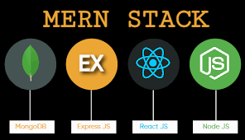
Introduction
The Blue Sky MERN Stack Application is a full-stack social media platform developed using the MERN (MongoDB, Express, React, Node.js) stack. It replicates core Twitter serviceability —tweeting, following, searching users—and integrates advanced features like file uploads (images/media) and data analysis/reporting, offering deeper user engagement and insights.

Slide 3
✨ Key Features
Here are the standout features included in the application:
👥 User Authentication (Register/Login using JWT)
📝 Create & View Tweets
🔍 Search for users
📁 File Uploads (Profile pictures, media with posts)
📢 Real-time Notifications

Slide 4
Existing System
🐦 Traditional Social Media Platforms – Case Study: Twitter
Twitter is a powerful microblogging platform that allows users to:
🗣️ Share thoughts via tweets (280 characters)
👥 Follow and engage with other users
📸 Attach media like images
🔍 Search for trending topics and users

Slide 5
Proposed System
🛠️ Building a Blue Sky Using MERN Stack
The proposed system addresses the limitations of traditional platforms by offering:
✅ Full control over the source code.
🔧 Feature extensibility including:
File uploads
Notifications
💬 Freedom to design the UX/UI
⚙️ Ease of maintenance and updates

Slide 6
Comparison Table
Feature | Twitter (Official) | MERN Clone
Open Source | ❌ No | ✅ Yes
Custom Features | ❌ Limited | ✅ Full Control
File Uploads | ✅ Yes | ✅ Yes
Real-Time Notifications | ✅ Limited Control | ✅ Custom Logic
Data Analysis | ❌ API Dependent | ✅ Direct Access to DB
Frontend Flexibility | ❌ No | ✅ Yes

Slide 7
Software Requirements
🧱 Category | 🛠️ Tools/Technologies
💻 Operating System: | Windows 10
💡 Framework | React.js for frontend, Node.js for backend
🎨 Programming Language | JavaScript
🧠 Database | MongoDB
🌐 Development Tools | Visual Studio Code (VS Code)

Slide 8
Hardware Requirements
💽 Component | 📋 Minimum Requirement
🧠 RAM | 4 GB
⚙️ Processor | 1.5 GHz Dual-Core
💾 Storage | 100 GB (for logs, DB, images)
🌐 Network | Stable internet connection for MongoDB Atlas or API testing

Slide 9
Work flow Diagram
Frontend (React + Vite + Tailwind)
|
↓
Backend API (Node.js + Express)
|
↓
Database (MongoDB + Mongoose)

Slide 10
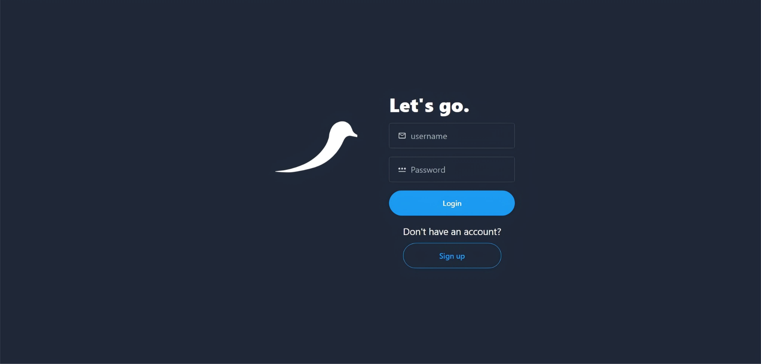
Screenshot
Login Page

Slide 11
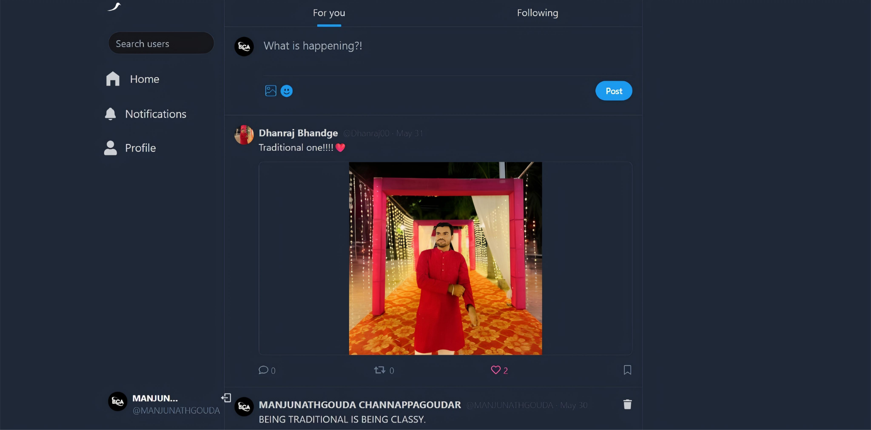
2. Home Page –

Slide 12
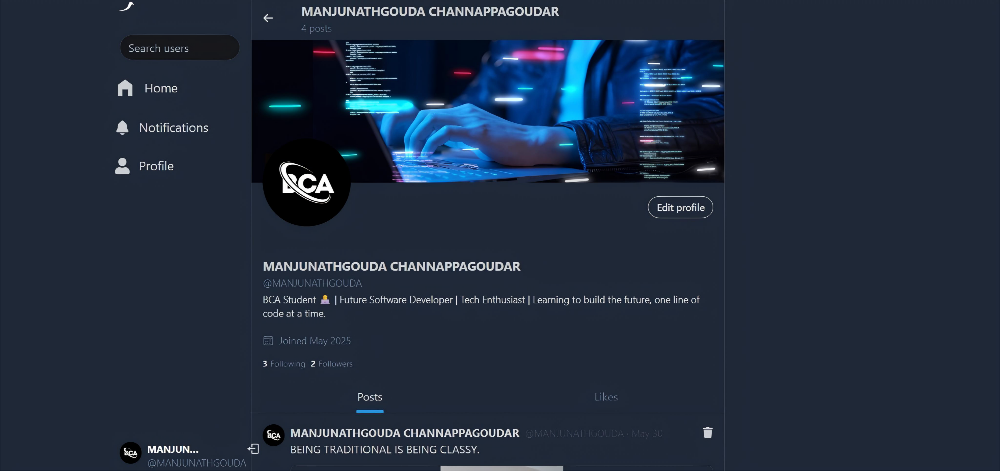
3. Profile Page –

Slide 13
Conclusion
This MERN Stack-based Blue Sky successfully replicates key features of a modern social media platform with improvement like file uploads and data analysis readiness. Users can sign up, post tweets (with images), search other users, and manage profiles—all within a fast, secure, and responsive environment

Slide 14
Future Enhancement
🔔 Real-Time Notifications: Integrate socket.io for push notifications.
📱 Mobile App Version: Using React Native for Android/iOS.

Slide 15
References
🔧 🔗 Core Technologies Documentation
Technology | Resource Link
MongoDB | https://www.mongodb.com/docs/
Express.js | https://expressjs.com/
React.js | https://reactjs.org/docs/
Node.js | https://nodejs.org/en/docs/
Tailwind CSS | https://tailwindcss.com/docs

Slide 16
Thank You

